Slide 1
Excel Final Re-Assessment
DENISHA PRIYA G
4274

Slide 2
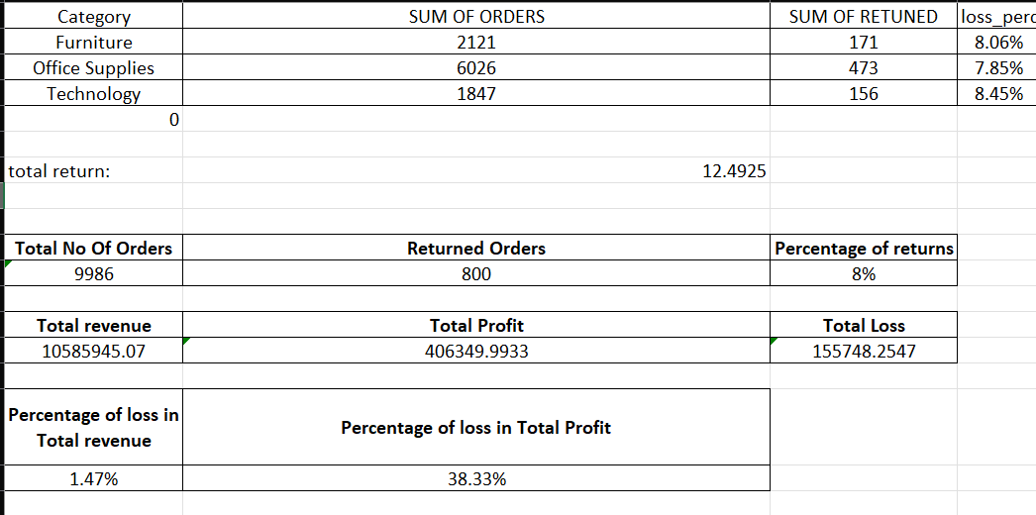
Question 1
FORMULA:
-COUNTA('Orders - copy'!A2:A9995)
-COUNTIF('Orders - copy'!Y2:Y9995,"Yes")
-A6/A3
-SUMIFS('Orders - copy'!V2:V9995,'Orders - copy'!Y2:Y9995,"No")
-SUMIFS('Orders - copy'!X2:X9995,'Orders - copy'!X2:X9995,">0",'Orders - copy'!Y2:Y9995,"No")
-ABS(SUMIFS('Orders - copy'!X2:X9995,'Orders - copy'!X2:X9995,"<0"))
-A18/A12
-A18/A15

Slide 3
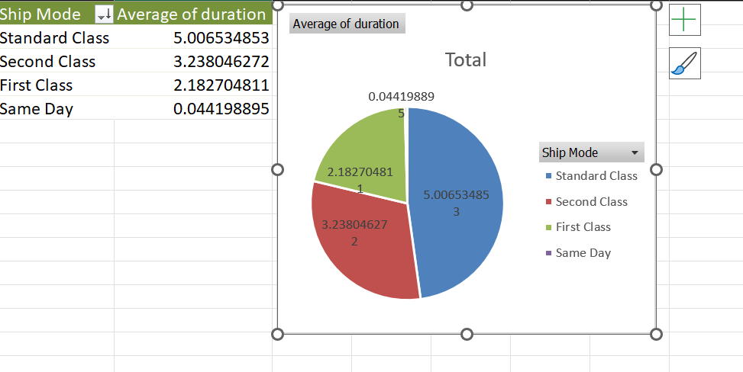
Question 2
Inference:
Shipping mode Standard class has high avg duration .
Thus it take more duration to ship.
Same day mode has the lowest delivery time.
Insights:
Create pivot table with the data.
Add shipmode in rows
Add duration in values
Plot Bar chart with the table
FORMULA:
Pivot and chart insertion

Slide 4
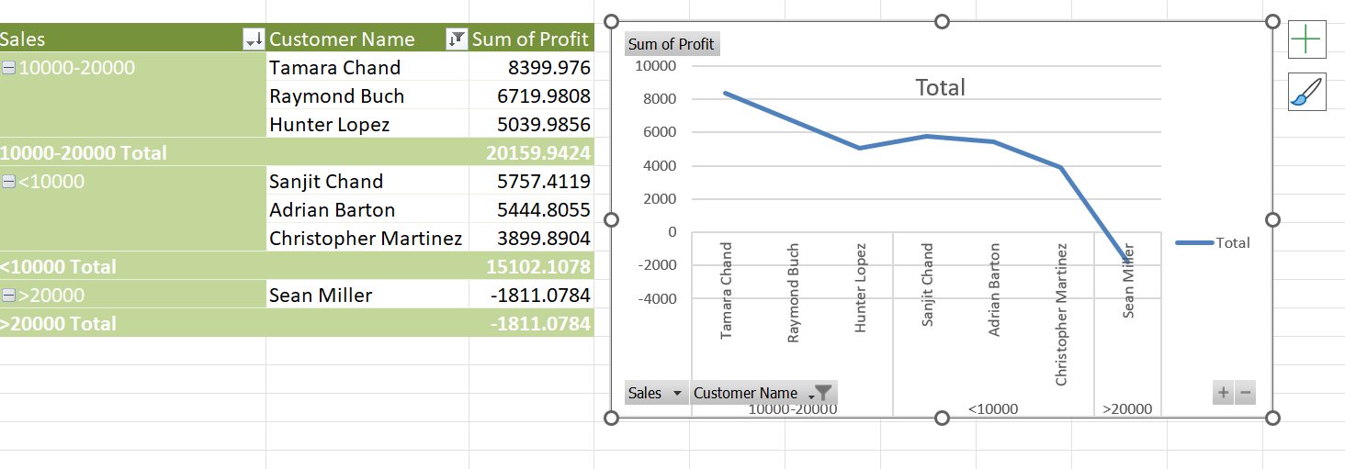
Question 3
INSIGHTS:
Segment containing the sales between 10000-20000 seems to be more valuable. They have a high profitability comparing to the other segments.
Inference:
Take the value of of sales in row and group them with the customername,
- Keep profit in value
FORMULA:
Pivot table

Slide 5
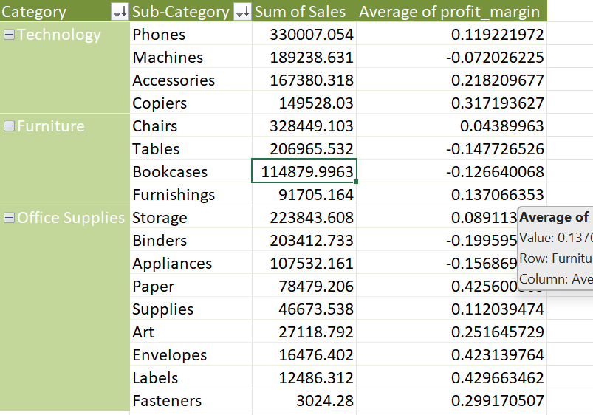
Question 4
INSIGHTS:
Category Technology with subcategory Phone has a high sales. Category office supplies and subcategory fasteners has less sales compared to the other category and hence need more improvement
inference
Create a pivot table
Have categoryand sub category in row and sales, profit_margin in value
FORMULA:
Pivot table

Slide 6
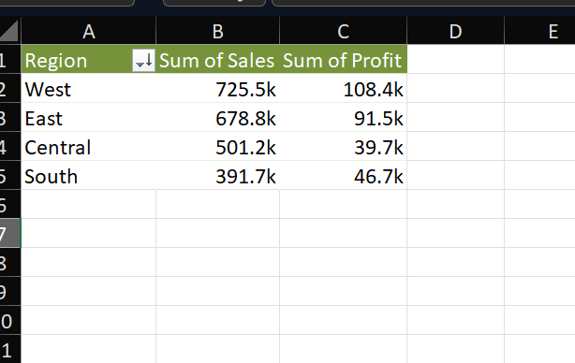
Question 5
INSIGHTS:
West region has the high sales and profit.
South has less sales and profit compared to the others region
Inference:
Create a pivot table
Have Region in row
Sales and profit in value
FORMULA:
Pivot table

Slide 7
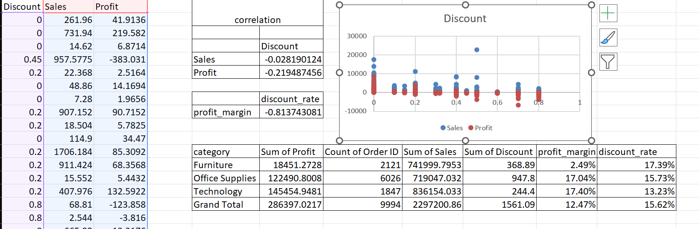
Question 6
INSIGHTS:
From the data it seems that discount and sales have a very weak negative correlation .
Discount and profit also have very weak nrgative correlation
Dicount rate and profit margin have strong negative correlation
Inference:
Take the value of discount, sales and profit .
Calculate the correlation using the formula.
Plot the scatter plot to get more insights
Also calculate correlation for profit margin and discount rate.
FORMULA:
Pivot table and chart insertion
=correl()

Slide 8
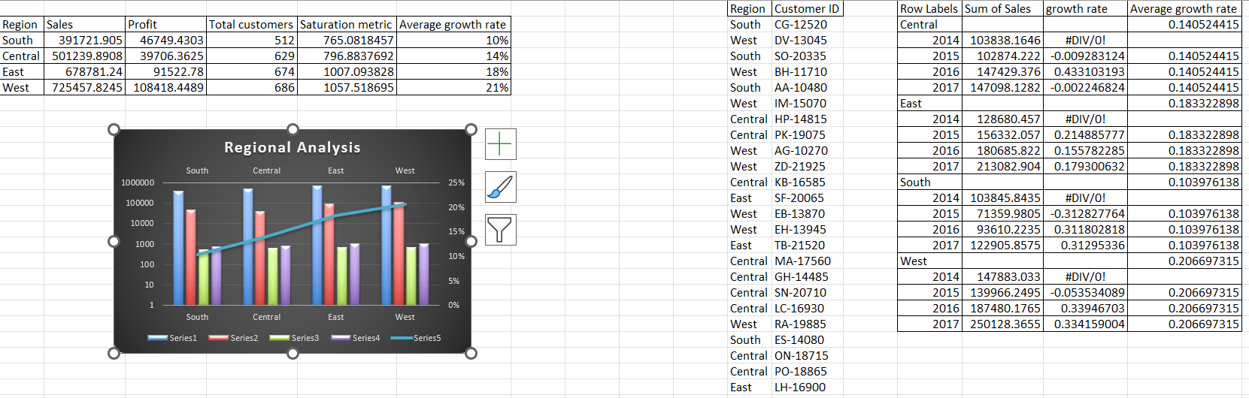
Question 7
Inference:
Took uniques of regions with their profit and sales .
Also found the no of customers
Found the saturation metric with the formula
INSIGHTS:
Here saturation metric is total sales divided by number of customers in that region
South has the lowest saturation metric
FORMULA:
Saturation metric= (current sales - previous sales)/previous sales

Slide 9
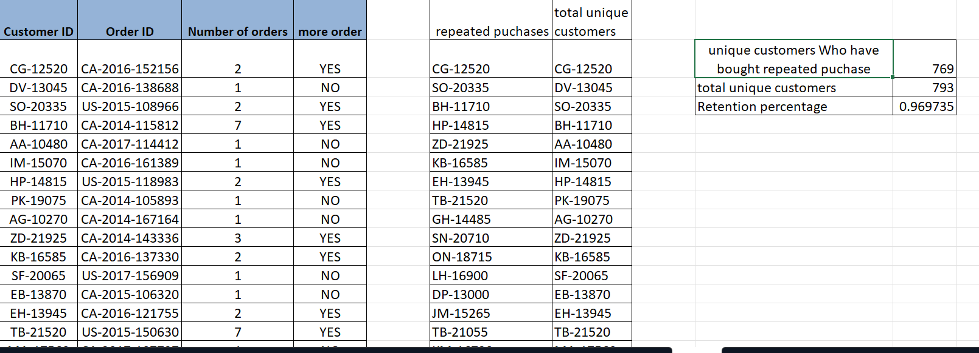
Question 8
Inference:
Find the customer purchased more than one order and get the count
- Find retention percentage by dividing repated customer by total customer
FORMULA:
= COUNTA(I1:I769)
= COUNTA(J2#)
=G4/G5
INSIGHTS:
There is unique customer who bought repeated product = 769
By the formula retention rate is 0.969

Slide 10
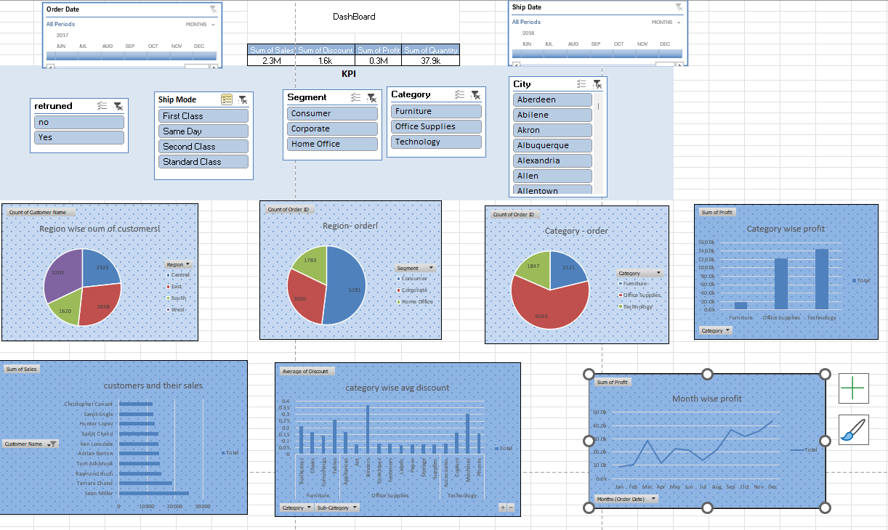
DashBoard

Slide 11
Dash Board
Inference:
we have region wise number of customer higher in west region and low in south region .
We could find a greate increase in profit in the holiday session – November to December .
And profit is more in technology comparing to the other category.
Number of orders in region , category wise.
FORMULA:
Pivot table , slicer, kpi, charts

